Slide 1
Set Up Free Email Forwarding
Lecturer: Ngo Huy Bien
Software Engineering Department
Faculty of Information Technology
VNUHCM - University of Science
Ho Chi Minh City, Vietnam
nhbien@fit.hcmus.edu.vn

Slide 2

Objectives

Slide 3

Contents

Slide 4

References

Slide 5
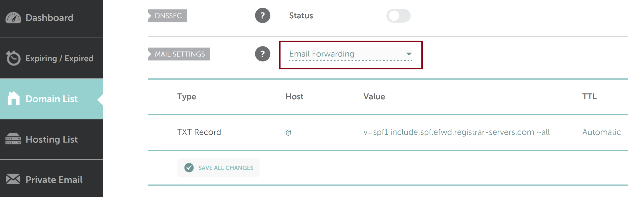
1. Enable Email Forwarding in NameCheap

Slide 6
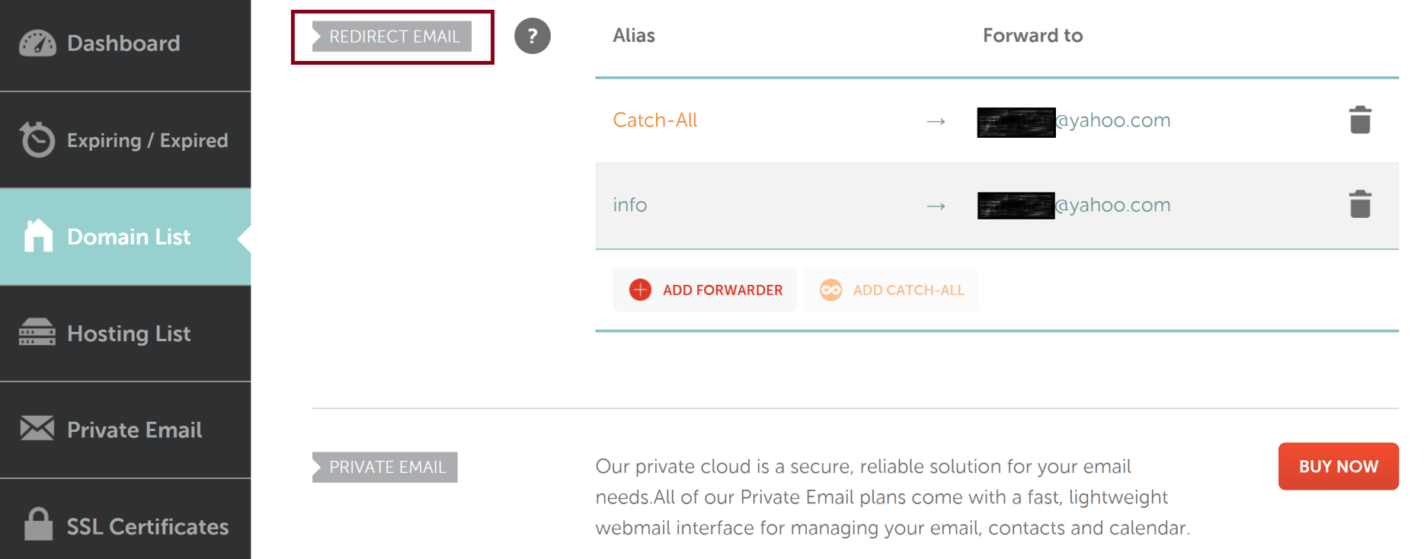
2 . Create Forwarding Email in NameCheap

Slide 7


Slide 8
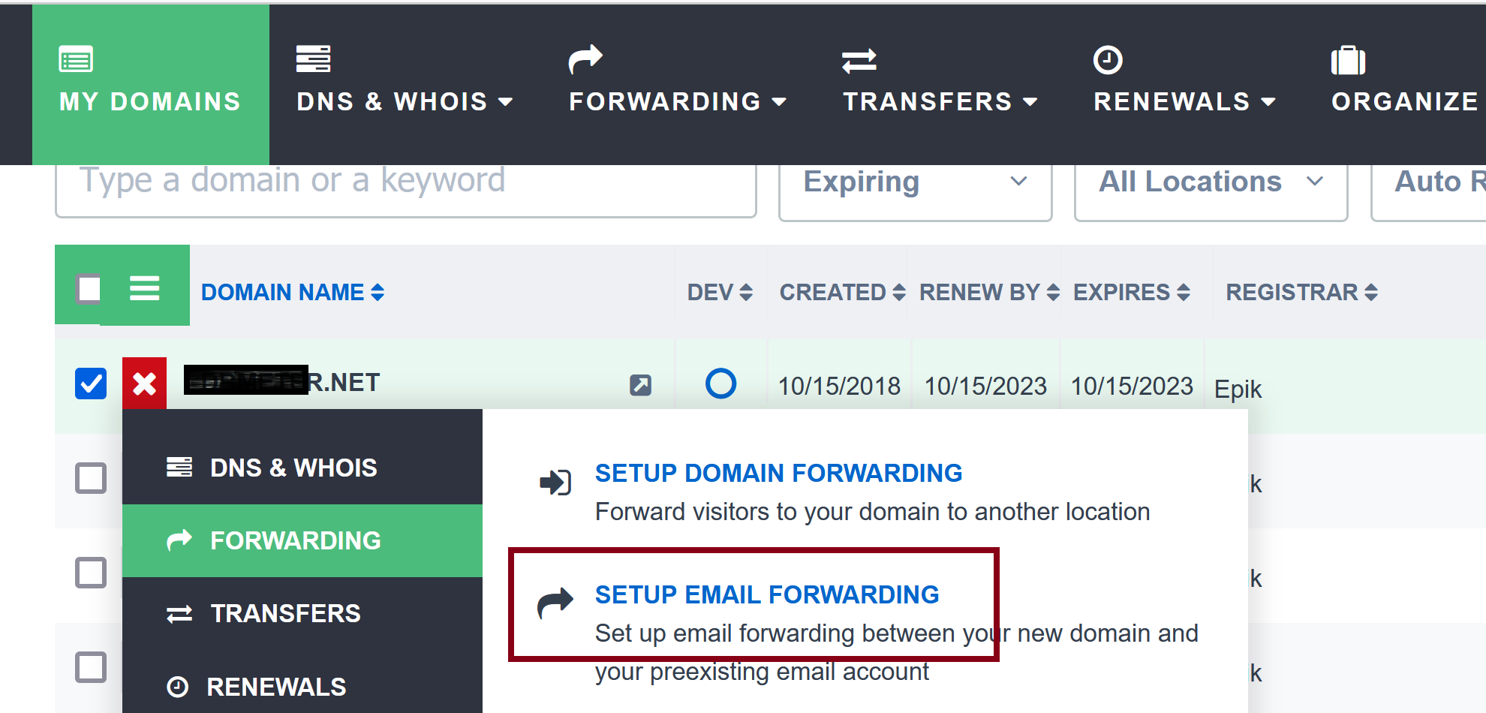
1. Enable Email Forwarding in Epik.com

Slide 9
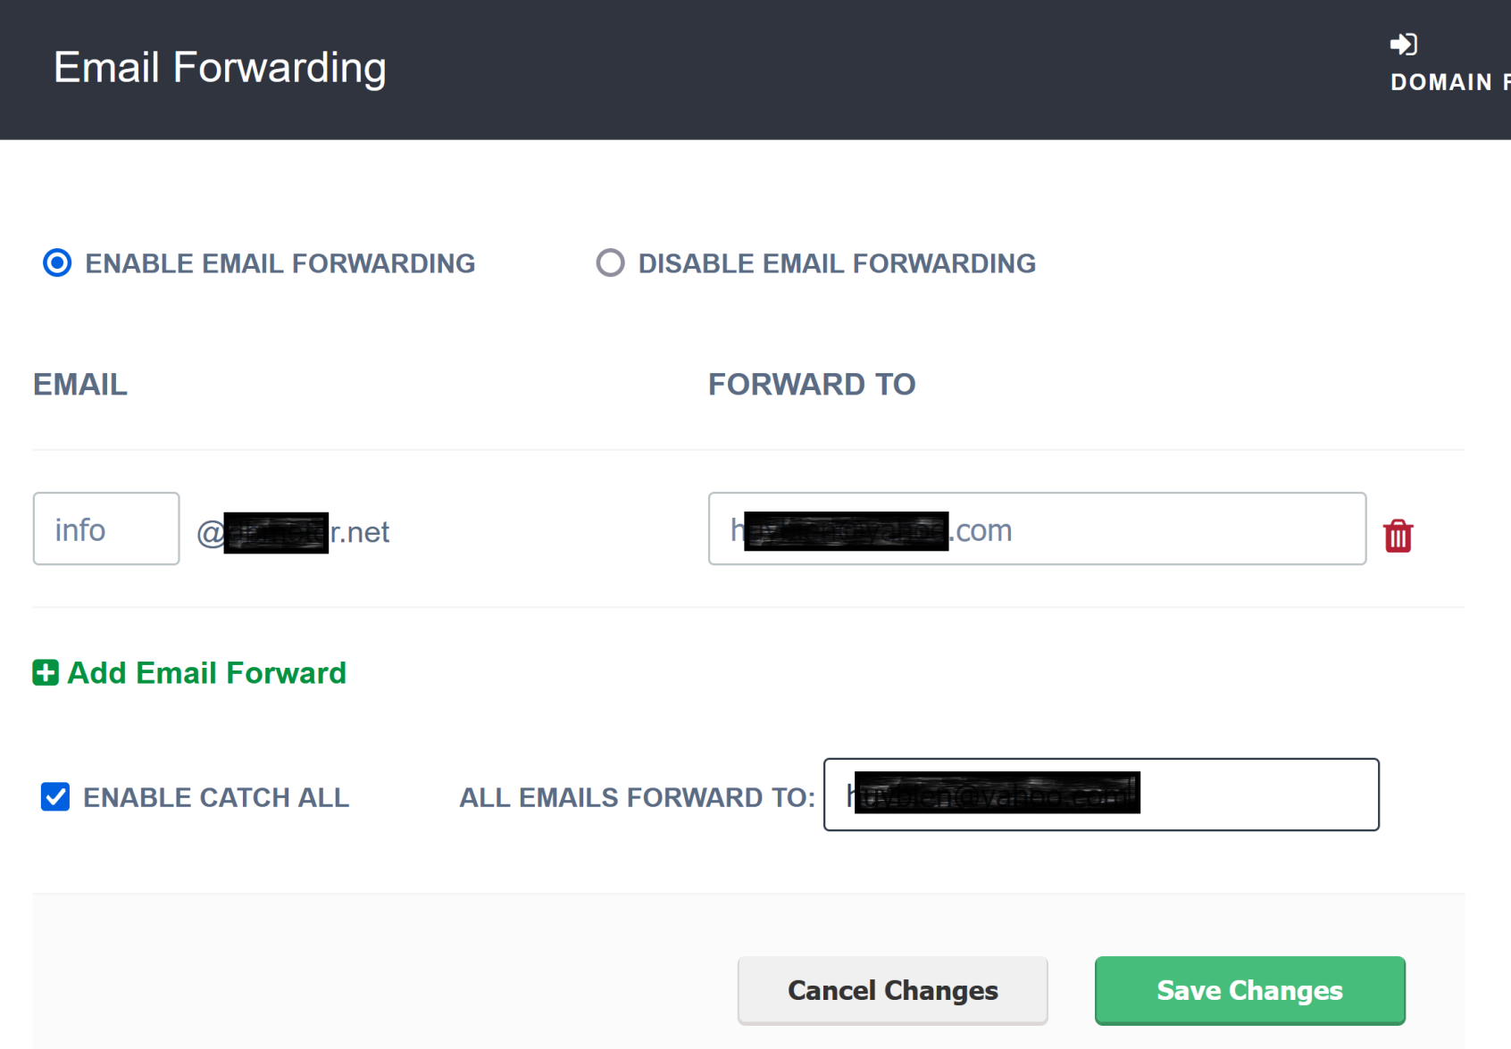
2 . Create Forwarding Email in Epik.com

Slide 10

Thank You & See You Again

